Slide 1
Song Play Count Predictor
Jieyu Chen, Wujie Duan, Xinyi Wang

Slide 2
Agenda
1
Introduction & Problem
2
Data Sampling & Preprocessing
Models & Results
4
Social Impact & Business Value
5

Slide 3
01
Problem

Slide 4
Problem
What will be the popularity (play count) of a song?
How can we know it?

Slide 5
02
Data Acquisition

Slide 6


Dependent Variable: Play Count
Predictors: 22 Features
A popular music App
Provides over 50 million tracks
22 features including audio features, track features, artist features and album features
A music platform
Records details of user’s activities
Offers data of each song’s play count
844,194 Observations

Slide 7
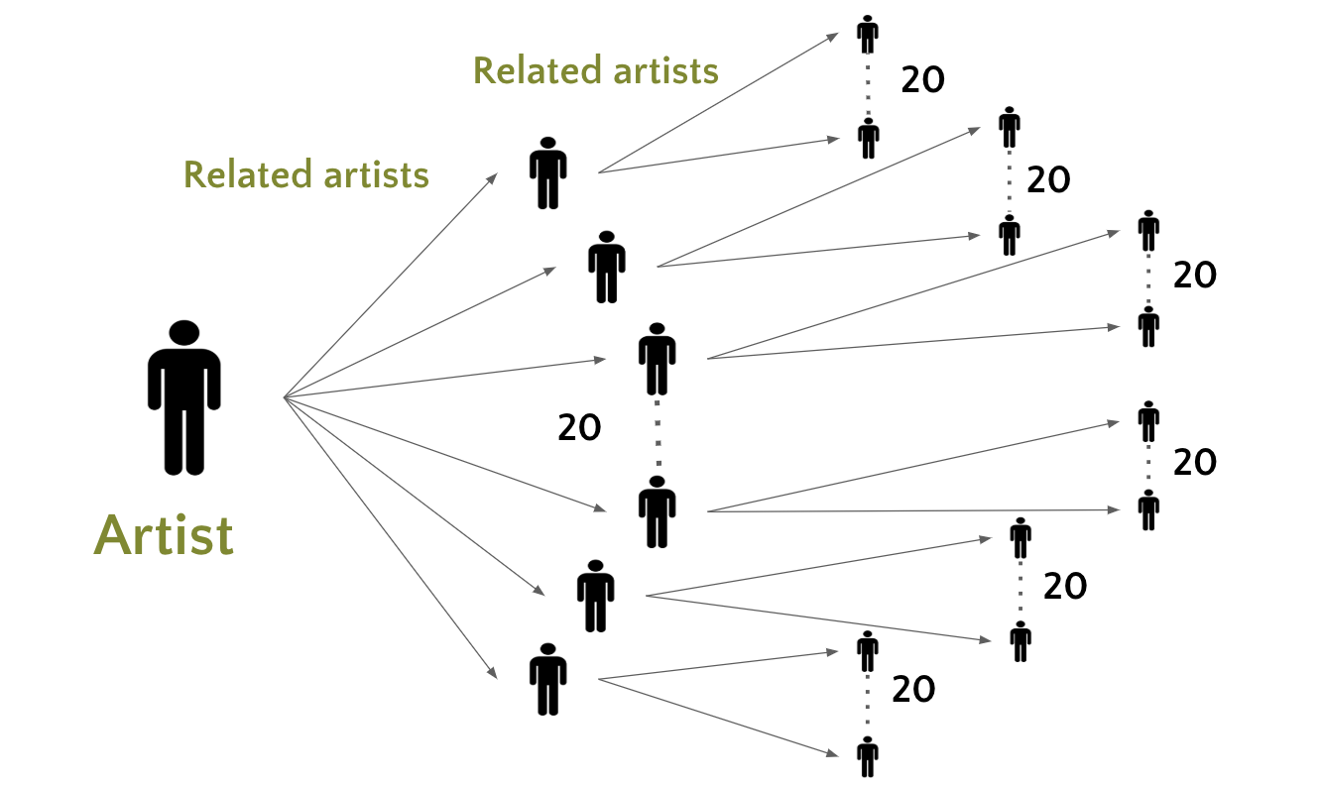
Snowball Sampling

Slide 8
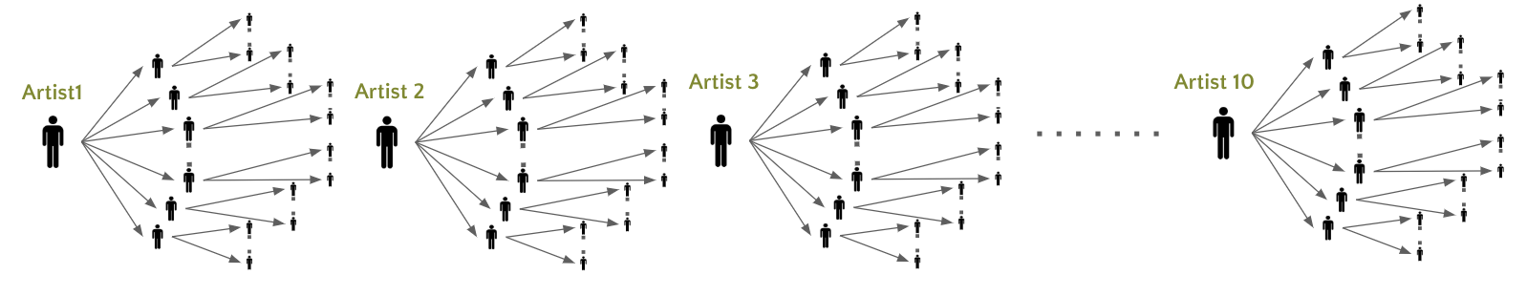
Snowball Sampling
“Using multiple sample seeds can increase sample diversity” ——Julian Kerchherr
10 Sample Seeds are Taylor Swift, Jun Zhen, Shigeru Umebayashi, Alizée, Wolfgang, Amadeus Mozart, Lana Del Rey, Jay Chou, Cuco, Eason Chen, Taichi Mukai

Slide 9
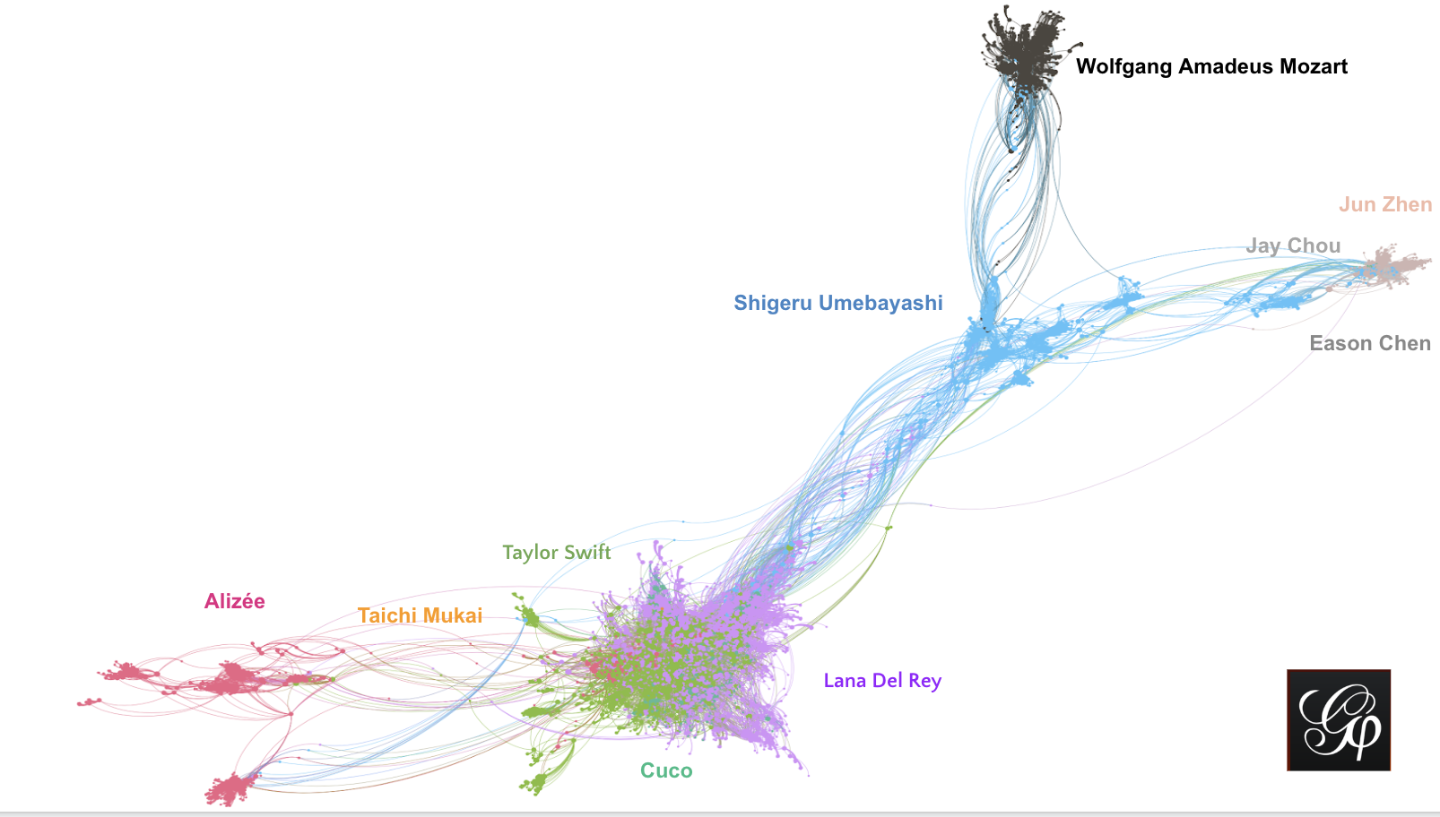
Snowball Sampling Visualization
Nodes: Artists
Edges: Connect related artists
Color: Starting point

Slide 10
Data Preprocessing
Categorical Data
One-hot encoding
Train Test Split
+
MinMax Scaling
Change the album release date to datetime type in python, then to the day counts from that date to 2019.12.3
One-hot encode the “country” variable and get two datasets: one with countries, one without
Delete Missing Values
Impute Missing Values
Drop the data point if missing “country”
Fill in the mean value calculated from the whole dataset for “album release date” and “artist followers”
with_countries.csv
(train + val + test)
no_country.csv
(train + val + test)

Slide 11
03
Models

Slide 12

1
Baseline
2
Linear Regression
3
SGD Regressor
Models
Linear SVR
4
5
Basic Neural Network
6
Random Forest
7
Result

Slide 13
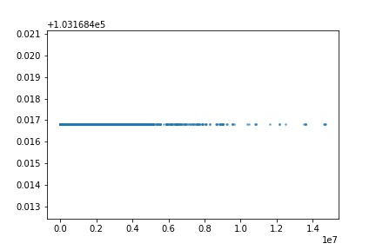
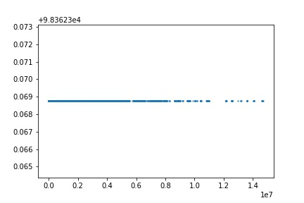
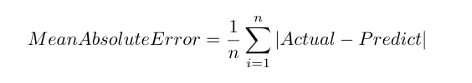
Baseline & MAE
Mean Value Prediction
The Dataset With The “Country” Feature
The Dataset Without The “Country” Feature

Slide 14
1
Baseline
2
Linear Regression(LR)
3
SGD Regressor
Model
Linear SVR
4
5
Basic Neural Network
6
Random Forest
7
Result

Slide 15
LR&SGD&SVR
Hyper-parameter Tuning
Random Search & Grid Search
Cross Validation

Slide 16
1
Baseline
2
Linear Regression
3
SGD Regressor
Model
Linear SVR
4
5
Basic Neural Network
6
Random Forest
7
Result

Slide 17
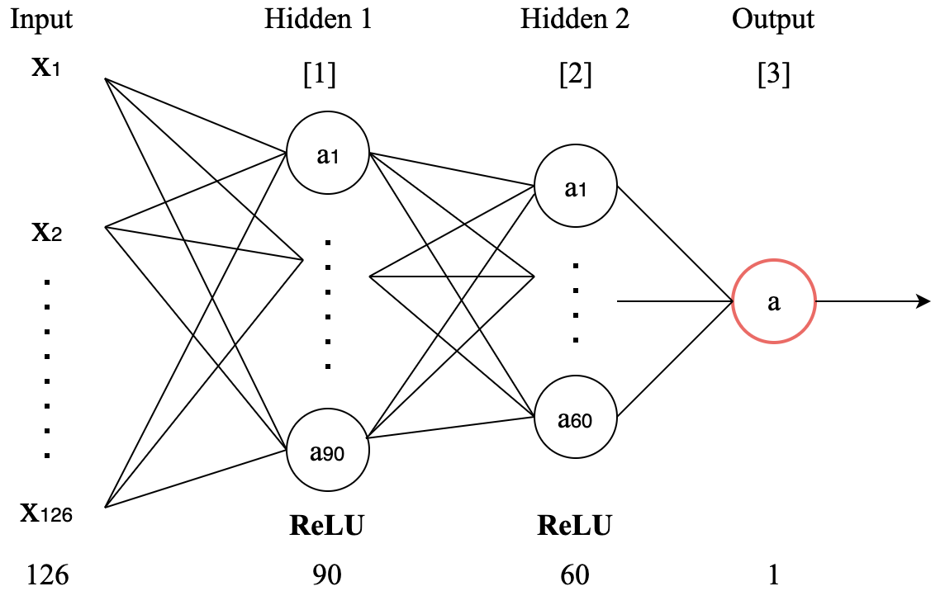
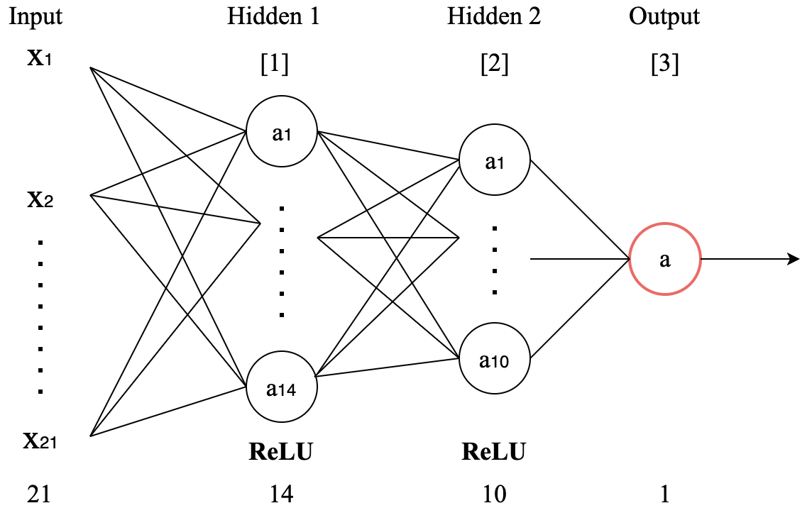
Basic Neural Network
The Dataset With The “Country” Feature
The Dataset Without The “Country” Feature

Slide 18
1
Baseline
2
Linear Regression
3
SGD Regressor
Model
Linear SVR
4
5
Basic Neural Network
6
Random Forest
7
Result

Slide 19
Random Forest Regression
1. Robustness – Less influenced by outliers
2. Bagging – Avoid high variance and high bias
3. Time Expenditure – High Efficiency

Slide 20
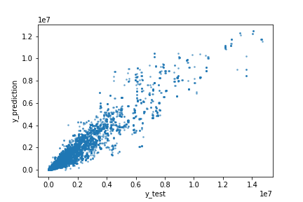
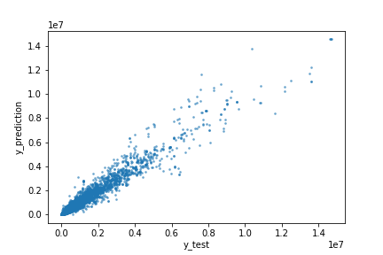
Random Forest
The Dataset With The “Country” Feature
The Dataset Without The “Country” Feature

Slide 21
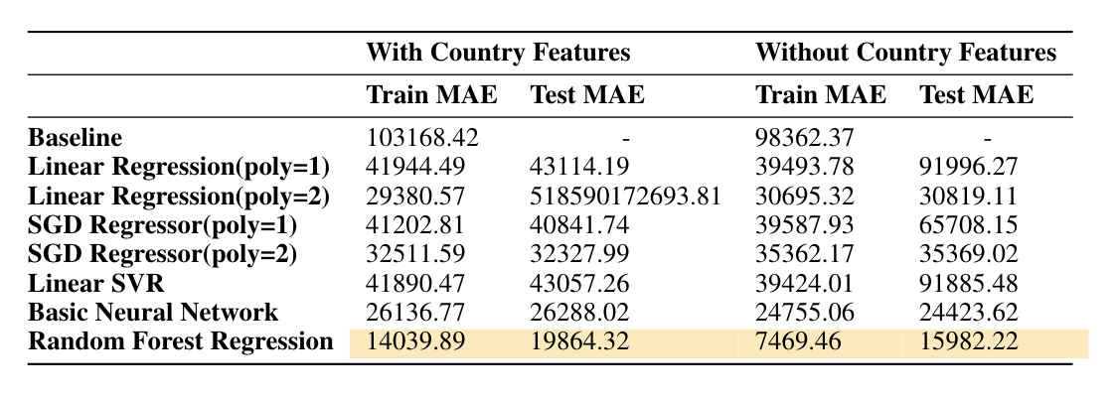
Result

Slide 22
04
Social Impact

Slide 23


Prediction Example
Jay Chou - 手写的从前(Handwritten Past)
Our Prediction: 23,988
Actual Play Count: ？
energy | … | artist_followers | album_available_markets
0.515 | … | 1250758 | 78
Mariah Carey – All I Want For Christmas Is You
Our Prediction: 5,939,326
Actual Play Count:？
energy | … | artist_followers | album_available_markets
0.9 | … | 4975024 | 30

Slide 24
Prediction Example
Jay Chou - 手写的从前(Handwritten Past)
Our Prediction: 23,988
Actual Play Count: 19,766
energy | … | artist_followers | album_available_markets
0.515 | … | 1250758 | 78
Mariah Carey – All I Want For Christmas Is You
Our Prediction: 5,939,326
Actual Play Count: 4,555,435
energy | … | artist_followers | album_available_markets
0.9 | … | 4975024 | 30

Slide 25
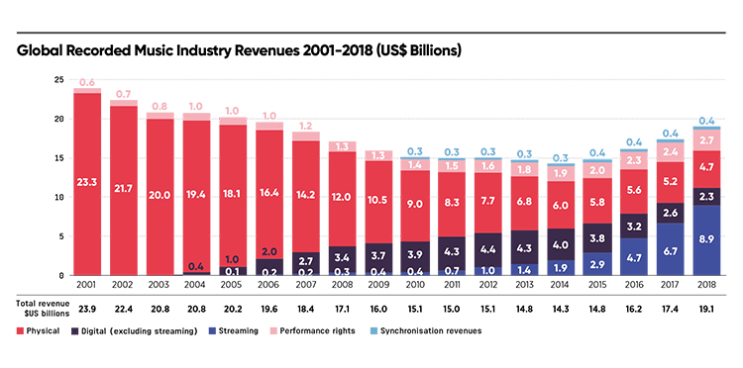
Business Value
Physical
Streaming
“along with the rise of consumer activity in digital music, there are new opportunities for research into using large music collections for discovering trends and patterns in music. ” —— Casey, M., Veltkam

Slide 26
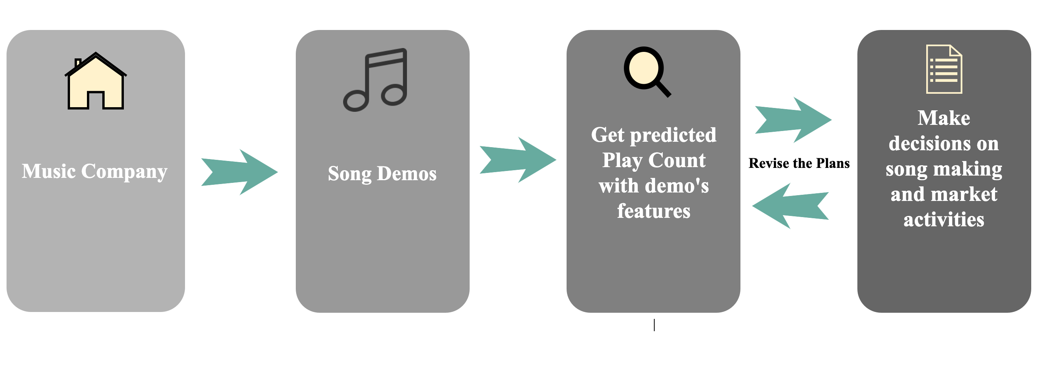
Business Flow

Slide 27






Future Work
Comprehensive Model:
Regional Information
Various Platforms

Slide 28
References
[1] Kirchherr J, Charles K (2018) Enhancing the samplediversity of snowball samples: Recommendations from aresearch project on antidam movements in SoutheastAsia. PLoS ONE 13 (8): e0201710.https://doi.org/10.1371/journal. pone.0201710
[2] IFPI Global Music Report 2019: Global Music Market Grows for Fourth Consecutive Year. (n.d.). Retrieved from https://musicbiz.org/news/ifpi-global-music-report-2019-global-music-market-grows-for-fourth-consecutive-year/.
[3] https://spotipy.readthedocs.io/en/latest/
[4] https://www.spotify.com/hk-en/
[5] https://github.com/pylast/pylast

Slide 29

Thank You
Special thanks to Professor Enric Junqué de Fortuny and TA Ruowen Tan
for all the help we get during this project!

